Slide 1
MINI PROJECT
ON TIME SERIES ANALYSIS
PREPARED BY – JITENDRA GIRISH PATIL

Slide 2
MINI PROJECT ON TIME SERIES ANALYSIS
TABLE OF CONTENTS –
Explanation of what the project is all about ?
Describing the data : Its source, datatypes, description and information.
Data Pre - Processing techniques used, How the missing value is handled and Feature engineering techniques used.
EDA and the interpretations from your visualizations.
Model building : whether used one model or more, Algorithms used in the model and the reason for choosing it and Cross validation result if used.
Evaluation of the performance of the models, and final conclusion of best model which can be used.

Slide 3
What the project is all about...
Every business owner's objective is to estimate the future trends — in terms of sales, profits, gains etc. To do this analysis, the owner first has to segregate the data by category and analyze each entity separately. For each entity, a forecast can be estimated based on the past sales of that entity. The idea behind this is to find out the popularity of a certain product and how its sales can impact the business.
Every product category is unique and cater to different customer base. So the analysis cannot be generalized that one trend is applicable to all products. A thorough insight into the past performance will reveal a lot of components that will enable the business to identify the trends.
To solve this issue we have to create model which can do forecasting of sales of furniture.

Slide 4
Describing the Data
The data contains total 9994 rows and 21 columns. Following are the columns and dtypes
FEATURE | DATA TYPE | DESCRIPTION
Row ID | Numeric | Unique row identifier
Order ID | Alphanumeric | Order ID
Ship Date | Date | Date when the order was shipped
Order Date | Date | Date when the order was made
Customer ID | Alphanumeric | Customer ID for which the order has been placed
Customer Name | Character | Customer name
Segment | Categorical | Type of Business (Consumer / Corporate / Home Office)
Country | Character | Customer's Country of origin
City | Character | Customer's city
State | Character | Customer's state
FEATURE | DATA TYPE | DESCRIPTION
Postal Code | Numeric | Address Zip code
Region | Categorical | Geographical location of the state within the country
Product ID | Alphanumeric | Product identification code
Category | Categorical | Product category.
Sub Category | Character | Specific product belonging to a given product category
Product Name. | Character | Product name
Sales | Numeric | Sales amount for the given order
Quantity | Numeric | Number of item(s) purchased against the order
Discount | Numeric | Discount offered on the selected product
Profit | Numeric | Overall profit made

Slide 5
Data Pre-Processing Techniques
Null Value Treatment - In Pre-Processing, First of all we checked for empty values, there were no empty values, so there is no need of missing value imputation.
Setting Date as Index- The Order Date column had shuffled dates so first of all the column was arranged in ascending order or dates and then made index for further modelling.
Data Selection– As the problem statement revolves around furniture prediction, All the data having category Furniture has been taken from the main data.
Checking Stationarity– Stationarity means over the period of time the mean and Variance(how much data points are deviated from mean). The Stationarity is checked and the data was stationary.

Slide 6
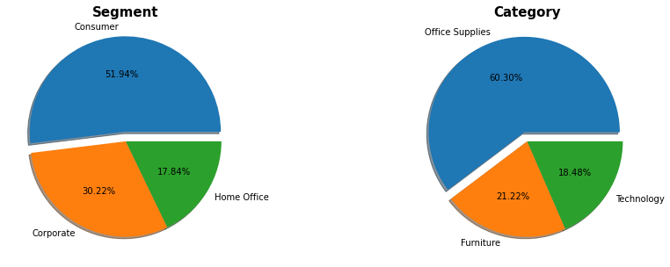
Exploratory Data Analysis
Interpretation :
- There are 51.94% of Segment that fall under consumer segment and only 17.84% in Home Office
- Most of the Sales is of Office Supplies Category which is upto 60.30% and least sales is of Technology which is 18.48%.

Slide 7
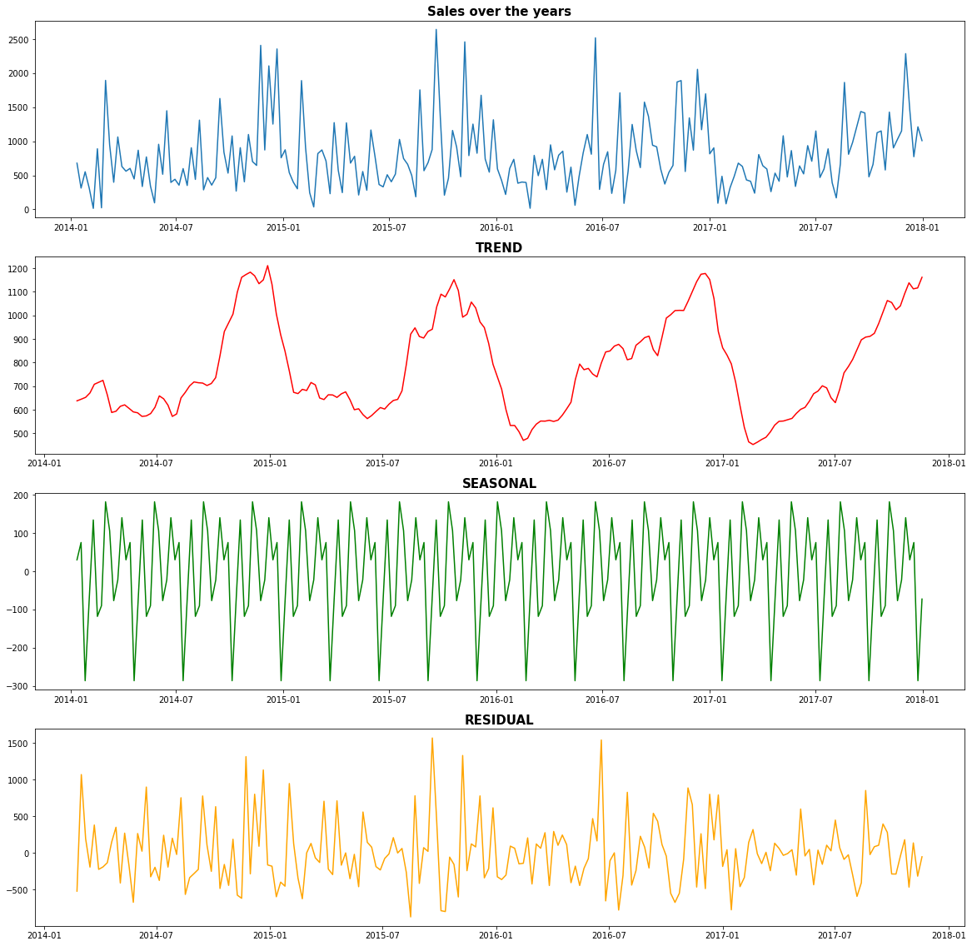
Exploratory Data Analysis
Interpretation :
The first graph shows us the actual sales graph.
In second graph we can see a trend which is a upward trend in sales.
The third graph shows us a repeated pattern which means there is some seasonality.
The fourth graph shows the irregularities in the dataset.

Slide 8
Model Building
There were total 2 models used to get the best model which can give the best forecasting. Following are the models
1. SARIMA – SARIMAX(), Seasonality ARIMA, as the data have seasonality SARIMA will be the better model than ARMA.
RMSE – 715.16
2. SARIMAX – SARIMAX(), The reason for choosing SARIMAX because SARIMAX depends on external factors like in this case profit, quantity and discount and based on those external parameter we can predict properly the sales prediction.
RMSE – 864.772

Slide 9
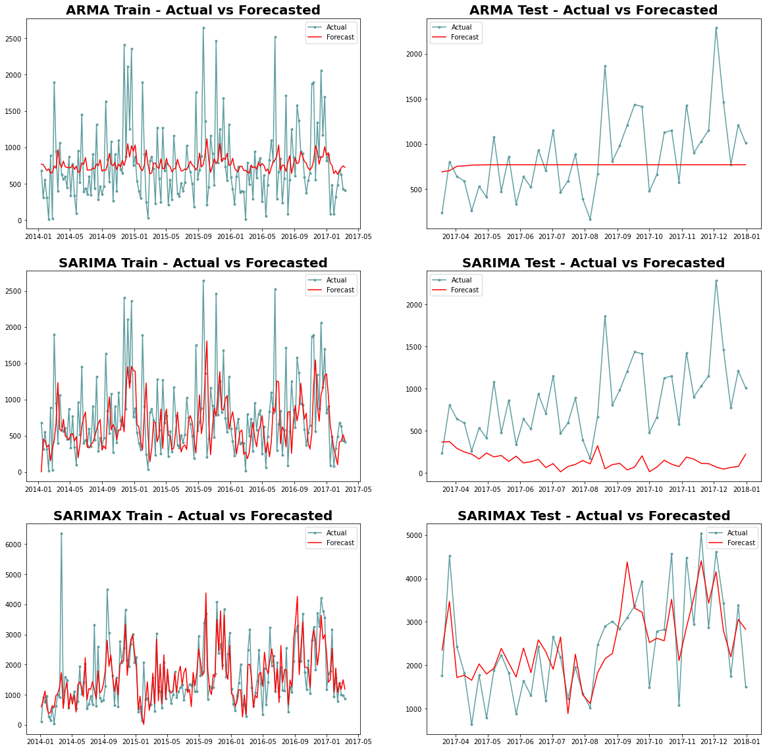
Evaluation and Final Conclusion of Best Model
Final Conclusion -
There were 2 models prepared for getting the best Forecasted Values :-
SARIMA and SARIMAX
SARIMAX MODEL can be said as best model among other models.
As the training and testing forecasted values are very well matching with actual data points line
The Forecasted line is also smoothened after removing noise.

Slide 10
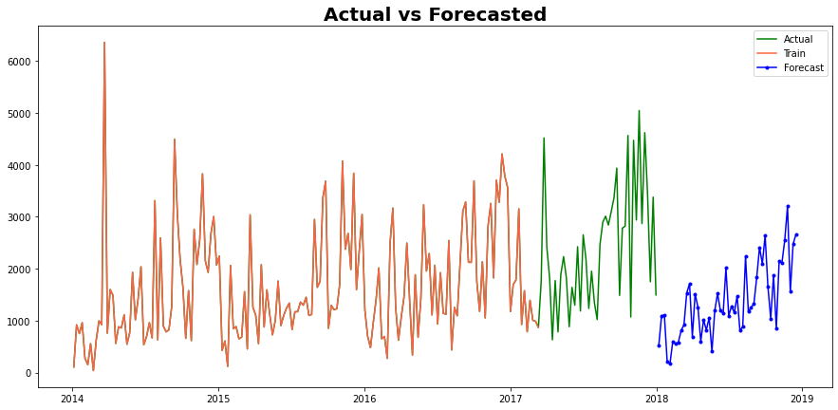
Business Implications
Having a Store in a Consumer Segment will
be beneficial for the sales and profit and will
be least in Home Office.
If Store owner have Furniture Category it
will give the business better opportunity than
Technology.
In every Segment most of the sales is 0
and maximum sales goes for Home Office which
is up to 25000.
Eastern and Western region have higher in Furniture Category so having business in these region will be better option.
Western region most of the sales is of Office Supplies and in South Region Technology Category have least sales.
So, Having store in Consumer segment will be a beneficial option for store owners and if the store is in eastern or in western region of country it will be a good deal to have at that place from the business perspective and based on Forecasting of 2 years of Furniture it suggests that Furniture sales will follow the same seasonality in 2018 and do good in the market.

Slide 11
THANK YOU

